Slide 1

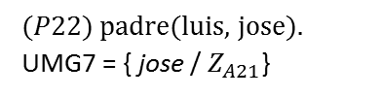

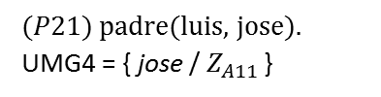
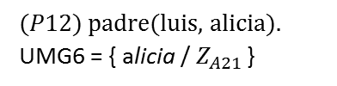


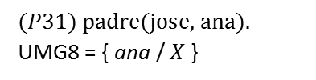


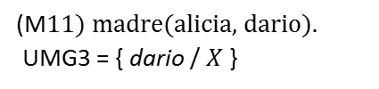


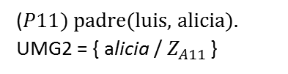


:- abuelo(luis , X).
$$(A11) {\text{abuelo}\text{(}X_{A11 }\text{,} Y_{A11 }\text{):−} \text{padre}\text{(}X_{A11 }\text{,} Z_{A11 }\text{)} \text{, }\text{madre}\text{(}Z_{A11 }\text{,}{ Y}_{A11 }\text{)}\text{.} }_{ }$$
UMG1 = { luis / $X_{A11 }$ , $X /{ Y}_{A11 }$}
$$(A21) {\text{abuelo}\text{(}X_{A21 }\text{,} Y_{A21 }\text{):−} \text{padre}\text{(}X_{A21 }\text{,} Z_{A21 }\text{)} \text{, }\text{p}\text{adre}\text{(}Z_{A21 }\text{,}{ Y}_{A21 }\text{)}\text{.} }_{ }$$
UMG5 = { luis / $X_{A21 }$ , $X /{ Y}_{A21 }$}
:- $\text{padre}\text{(}\text{luis}\text{ , }Z_{A11 }\text{) , }\text{madre}\text{(}Z_{A11 }\text{,} \text{X}\text{)}\text{.}$
:- $\text{padre}\text{(}\text{luis}\text{ , }Z_{A21 }\text{) , }\text{padre}\text{ (}Z_{A21 }\text{,} \text{X}\text{)}\text{.}$
($P11) {\text{padre}\text{(}\text{luis}\text{, }\text{alicia}\text{)}\text{.} }_{ }$
UMG2 = { alicia / $Z_{A11 }$}
$(P21) {\text{padre}\text{(}\text{luis}\text{,} \text{jose}\text{)}\text{.} }_{ }$
UMG4 = { jose / $Z_{A11 }$}
$(P12) {\text{padre}\text{(}\text{luis}\text{, }\text{alicia}\text{)}\text{.} }_{ }$
UMG6 = { alicia / $Z_{A21 }$}
$(P22) {\text{padre}\text{(}\text{luis}\text{, }\text{jose}\text{)}\text{.} }_{ }$
UMG7 = { jose / $Z_{A21}$}
$$:− {\text{madre}\text{(}\text{alicia}\text{, }\text{X}\text{)}\text{.} }_{ }$$
$$:− {\text{madre}\text{(}\text{jose}\text{, }\text{X}\text{)}\text{.} }_{ }$$
$$:− {\text{padre}\text{(}\text{alicia}\text{, }\text{X}\text{)}\text{.} }_{ }$$
$$:− {\text{padre}\text{(}\text{jose}\text{, }\text{X}\text{)}\text{.} }_{ }$$
(M$11) {\text{madre}\text{(}\text{alicia}\text{, }\text{dario}\text{)}\text{.} }_{ }$
UMG3 = { dario / $X$}
fail
fail
$(P31) {\text{padre}\text{(}\text{jose}\text{, }\text{ana}\text{)}\text{.} }_{ }$
UMG8 = { ana / $X$}
SRC = { dario / $X$}
SRC = { ana / $X$}

